Slide 1
CSCI2100E Sorting

Slide 2


Create a New Account
Google Mail and Yahoo Mail have hundreds of millions of users.
A user can create a new account at any time.
When a user types a new name, the system will tell the user whether the name has been used or not immediately after the user types the enter key.
If this cannot be done, the user will go to the competitor’s website.

Slide 3
Sorting Records
Consider a collection of records, where a record has several fields.
For example, for a student record, we can have name, student identifier, telephone number, etc.
We want to arrange all the records in order by some key, where a key is a field in a record.
Student name, student identifier, telephone number, etc.
It can be done by sorting.
In this chapter, we focus on numbers when we discuss sorting. The same ideas can be applied to other data fields.

Slide 4
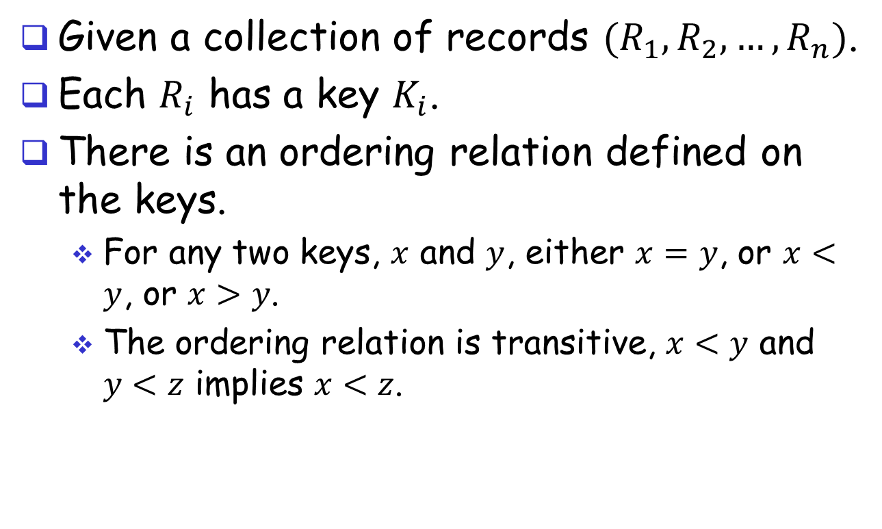
More About Sorting
Given a collection of records $(R_{1},R_{2},…,R_{n})$.
Each $R_{i}$ has a key $K_{i}$.
There is an ordering relation defined on the keys.
For any two keys, $x$ and $y$, either $x=y$, or $x<y$, or $x>y$.
The ordering relation is transitive, $x<y$ and $y<z$ implies $x<z$.

Slide 5
Some Sorting Algorithms
We discussed simple sort and selection sort in Chapter 1.
We will discuss insertion sort, quick sort, merge sort, and heap sort.
Some questions in mind.
Do we need to learn that many?
Do we only need to know the best one?
By the way, is there the best one?

Slide 6
Data to Be Sorted
We consider a data structure called element. typedef struct { int key; ….; } element;
Given an array of such elements, we sort the elements based on their key values.
For simplicity, we assume that we talk about sorting numbers.

Slide 7
One Main Idea
Consider sorting numbers in an array in order.
Always consider the array has two portions: the sorted portion followed by the unsorted portion.
Initially, the sorted portion is empty, and the entire array is unsorted.
The algorithm enlarges the sorted portion by adding one more number in every iteration, and shrinks the unsorted portion accordingly.
While the unsorted portion is not empty, move the one number from the unsorted portion to the sorted portion, and make the sorted portion sorted.

Slide 8

Simple Sort & Selection Sort
#define SWAP(x, y, t) ((t)=(x), (x)=(y), (y)=(t))
void simpleSort(int a[ ], int n)
{ int i, j, temp;
for (i = 0; i < n-1; i++) {
for (j = i+1; j < n; j++)
if (a[j] < a[i])
swap(a[i], a[j], temp);
}
}
}
The time complexity is the same $O(n2)$. Which one is faster?
Simple sort: $g(n) = \frac{5}{2}n(n−1)+2n−1$(worst case)
Selection sort: $g(n)=\frac{3}{2}n(n−1)+6n+1$(worst case)
void selectionSort(int a[], int n)
{ int i, j, min, temp;
for (i = 0; i < n-1; i++) {
min = i;
for (j = i+1; j < n; j++)
if (a[j] < a[min])
min = j;
swap(a[i], a[min], temp); }}
Notes:
D/E-class 20060118 Wed

Slide 9
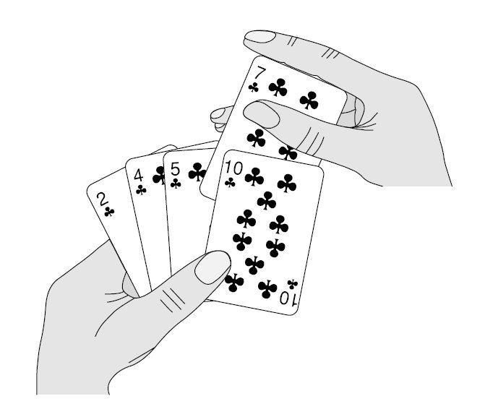
Insertion Sort
Insert a new record into a sorted sequence of i records in such a way that the resulting sequence of size i+1 is also sorted.
In the textbook, it uses an array a[] of size n+1, it is to sort records in the range of a[1..n].
a[0] is used to temporarily keep a record.

Slide 10
Insertion Sort
Consider to insert a record e to the correct position in the range of a[1..i], following the ordering relation.
Suppose it is at a position a[k], then all a[k..i] must be shifted to right by one.
Let it be done by a procedure called insert. void insert(int e, int a[], int i) { a[0] = e; while (e < a[i]) { a[i+1] = a[i]; i--; } a[i+1] = e; }

Slide 11
Insertion Sort
Sort a[1]..a[n] into a non-decreasing order. void insert(int e, int a[], int i) { a[0] = e; while (e < a[i]) { a[i+1] = a[i]; i--; } a[i+1] = e; }
void insertionSort(int a[], int n) { int j, temp; for (j = 2; j <= n; j++){
temp = a[j]; insert(temp, a, j-1); /* insert a[j] into a[1..j-1] */ } }

Slide 12
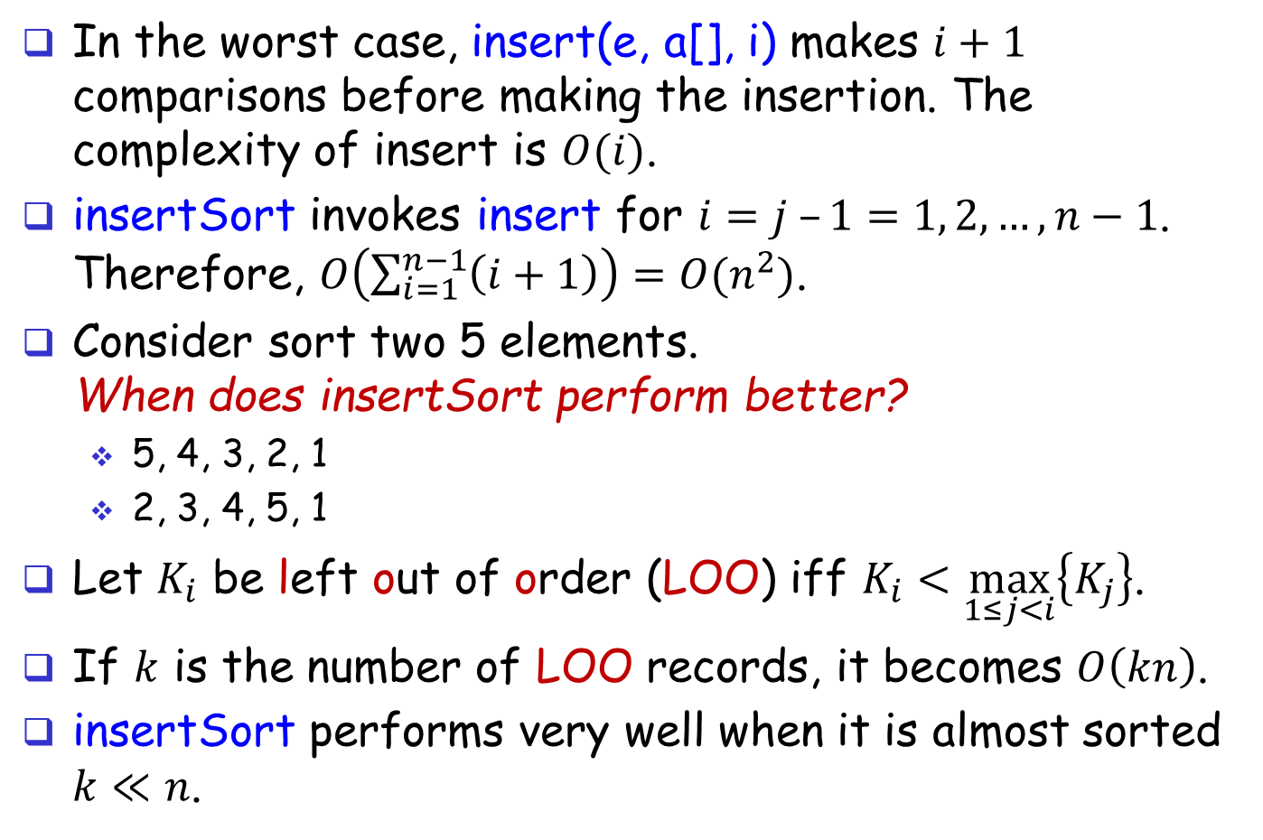
Insertion Sort
In the worst case, insert(e, a[], i) makes $i+1$ comparisons before making the insertion. The complexity of insert is $O(i)$.
insertSort invokes insert for $i=j –1=1, 2, …, n−1$. Therefore, $O\left(\sum_{i=1}^{n−1}{\left(i+1\right)}\right)=O(n^{2})$.
Consider sort two 5 elements. When does insertSort perform better?
5, 4, 3, 2, 1
2, 3, 4, 5, 1
Let $K_{i}$ be left out of order (LOO) iff $K_{i}<\max_{1≤j<i}\left\{K_{j}\right\}$.
If $k$ is the number of LOO records, it becomes $O\left(kn\right)$.
insertSort performs very well when it is almost sorted $k≪n$.

Slide 13
Other Thoughts?
So far, we try to determine the position where a number must be placed, when sorting.
Can we sort without determining the positions? Or in other words, to determine the positions later.

Slide 14
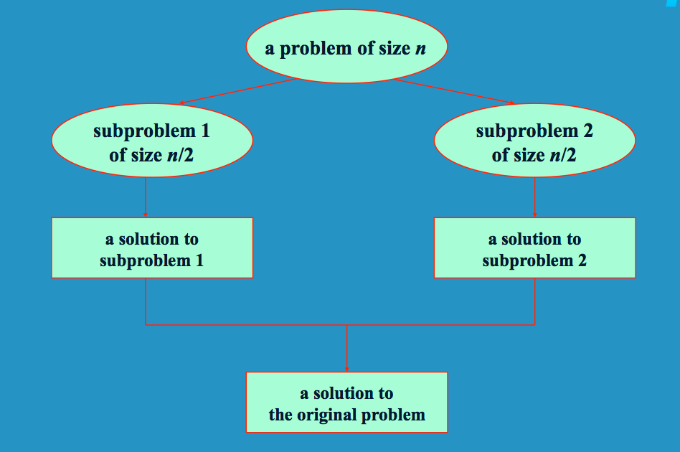
Divide & Conquer
Divide & Conquer is an approach that solves a big problem by dividing the big problem into small problems and solve the small problems, which solves the big problem.
One example.

Slide 15

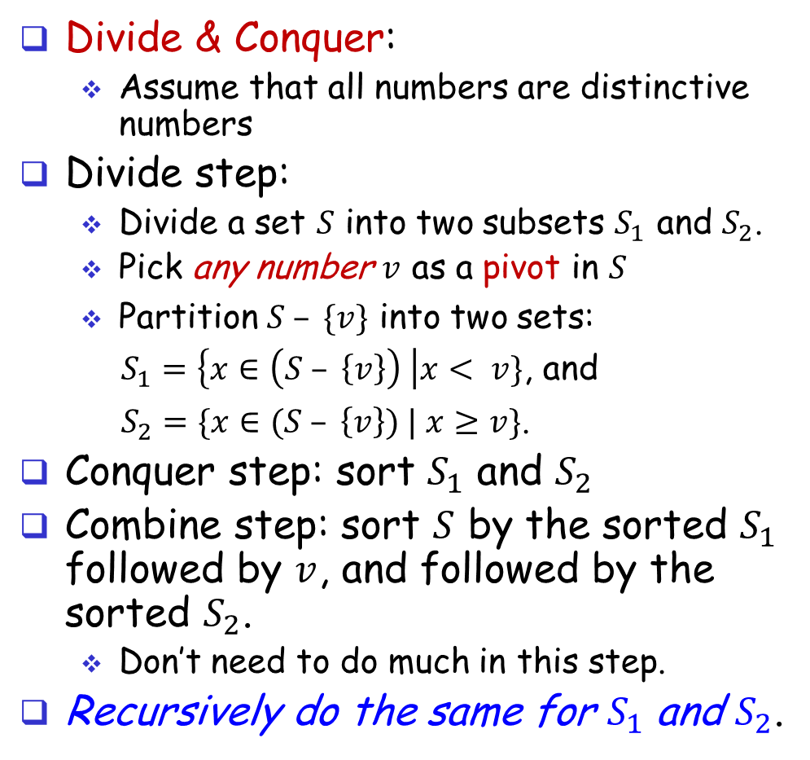
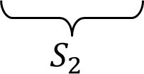
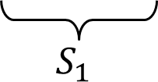


Quicksort (Divide & Conquer)
Divide & Conquer:
Assume that all numbers are distinctive numbers
Divide step:
Divide a set 𝑆 into two subsets $S_{1}$ and $S_{2}$.
Pick any number $v$ as a pivot in $S$
Partition $S – \{v\}$ into two sets:
$S_{1}=\left\{x∈\left(S – \left\{v\right\}\right) \right|x< v\}$, and
$S_{2}=\{x∈(S – \left\{v\right\}) | x≥v\}$.
Conquer step: sort $S_{1}$ and $S_{2}$
Combine step: sort $S$ by the sorted $S_{1}$ followed by $v$, and followed by the sorted $S_{2}$.
Don’t need to do much in this step.
Recursively do the same for $S_{1}$ and $S_{2}$.
$$S$$
$$v$$
$$v$$
$$S_{1}$$
$$S_{2}$$

Slide 16
A Quicksort Example
81
43
31
57
75
13
92
65
26
0
Select 65 a pivot
81
43
31
57
75
13
65
26
0
92
Divide by partition
13
31
57
65
81
43
26
0
92
75
Do the same to select a pivot, …
Do the same to select a pivot, …
0
13
26
31
43
57
75
81
92
Combine
0
13
26
31
43
57
65
75
81
92

Slide 17
QuickSort
The pseudo code. Refer to Program 7.6 in the textbook. quickSort(int a[], int left, int right){ if (left < right) { select a pivot v in a[left..right]; move a[i] < v to left (a[left..p-1]); move a[i] >= v to right (a[p+1..right]); a[p] = v; /* a[p] keeps the pivot value v */ quickSort(a, left, p-1); quickSort(a, p+1, right); } }
Partition

Slide 18
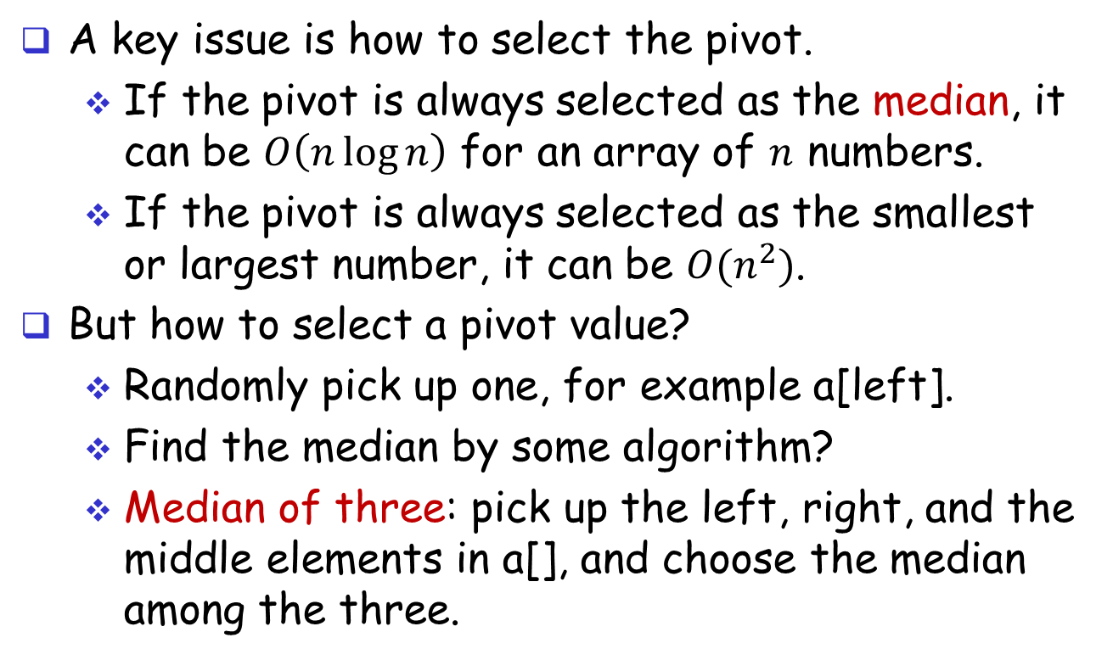
QuickSort: Pivot Selection
A key issue is how to select the pivot.
If the pivot is always selected as the median, it can be $O\left(n\log{n}\right)$ for an array of $n$ numbers.
If the pivot is always selected as the smallest or largest number, it can be $O(n^{2})$.
But how to select a pivot value?
Randomly pick up one, for example a[left].
Find the median by some algorithm?
Median of three: pick up the left, right, and the middle elements in a[], and choose the median among the three.

Slide 19
QuickSort: Partition
Suppose we use an additional array b[] to do the partition for a[] of size n.
Let the pivot value be p.
Let i = 0 and j = n-1.
Scan a[k] from k=0 to n. If a[k] < p, then place it at b[i++] from the left. If a[k] > p, place it at b[j--] from the right. Finally, place p at the remaining slot.
What is the problem? Take additional space of b[].

Slide 20
QuickSort: In-Place Partition
To partition a[left..right] using a[] only. If the pivot value is not the leftmost, swap it with the leftmost number; p = a[left]; l = left + 1; r = right;
while (l <= r){
while (l <= right && a[l] < p) l = l + 1;
while (r > left && a[r] >= p) r = r – 1;
if (l < r) swap a[l] and a[r]; }
/* a[r]<p holds */
a[left] = a[r]; a[r] = p;

Slide 21
Example of In-Place Partition
select pivot: 4 3 6 9 2 4 3 1 2 1 8 9 3 5 6
search: 4 3 6 9 2 4 3 1 2 1 8 9 3 5 6
swap: 4 3 3 9 2 4 3 1 2 1 8 9 6 5 6
search: 4 3 3 9 2 4 3 1 2 1 8 9 6 5 6
swap: 4 3 3 1 2 4 3 1 2 9 8 9 6 5 6
search: 4 3 3 1 2 4 3 1 2 9 8 9 6 5 6
swap: 4 3 3 1 2 2 3 1 4 9 8 9 6 5 6
search: 4 3 3 1 2 2 3 1 4 9 8 9 6 5 6 (l>r)
swap with pivot: 1 3 3 1 2 2 3 4 4 9 8 9 6 5 6
We just move numbers around. As a result, we sort numbers.

Slide 22
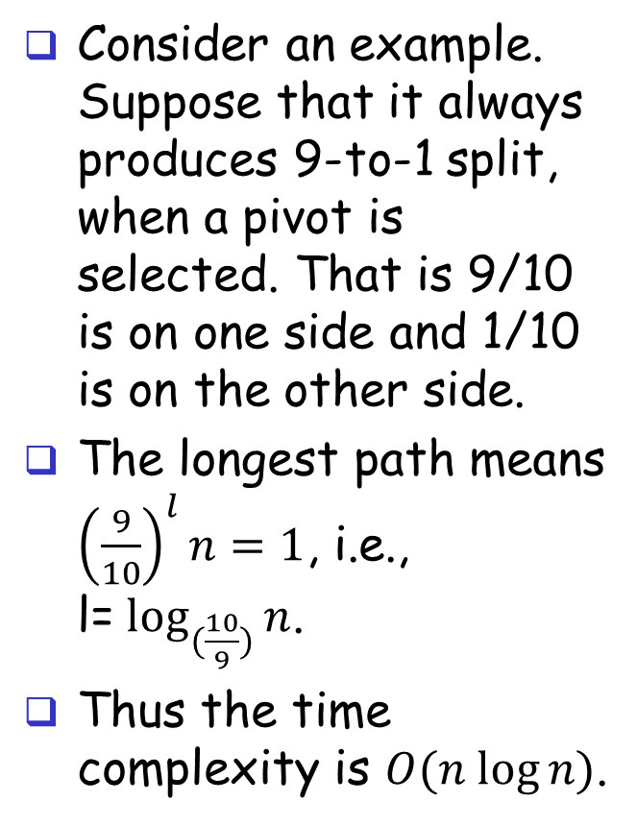
The Average-Case for QuickSort
Consider an example. Suppose that it always produces 9-to-1 split, when a pivot is selected. That is 9/10 is on one side and 1/10 is on the other side.
The longest path means ${\left(\frac{9}{10}\right)}^{l}n=1$, i.e., l=$\log_{(\frac{10}{9})}⁡n$.
Thus the time complexity is $O(n log⁡n)$.

Slide 23
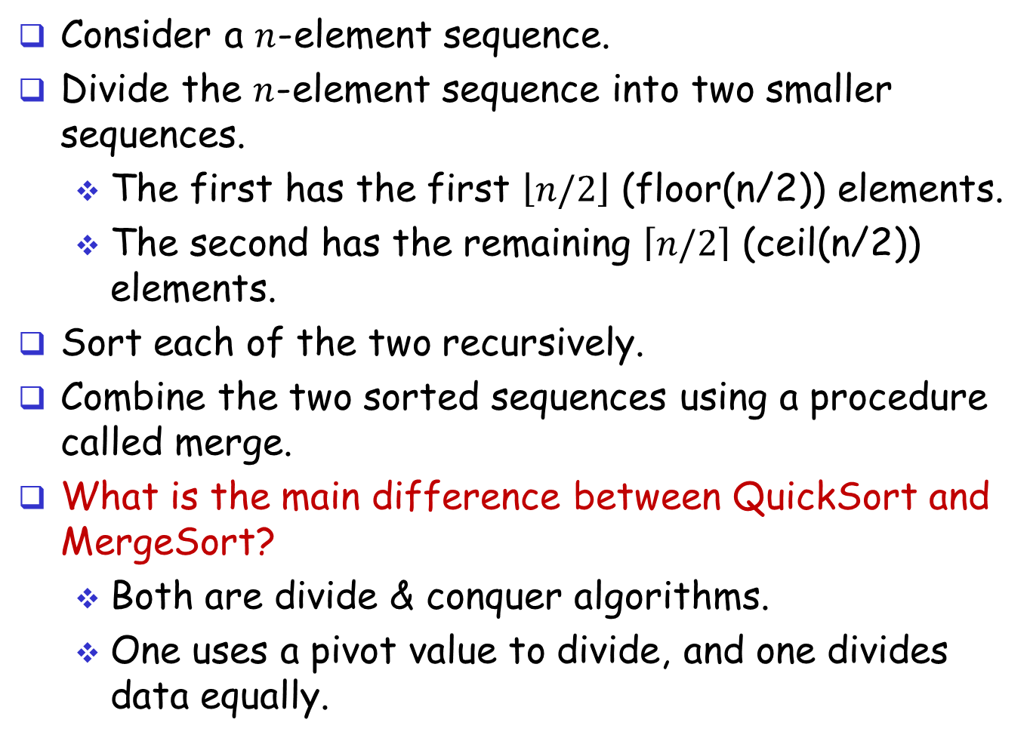
Merge Sort (Divide & Conquer)
Consider a $n$-element sequence.
Divide the $n$-element sequence into two smaller sequences.
The first has the first $\left\lfloor n/2\right\rfloor$ (floor(n/2)) elements.
The second has the remaining $\left\lceil n/2\right\rceil$ (ceil(n/2)) elements.
Sort each of the two recursively.
Combine the two sorted sequences using a procedure called merge.
What is the main difference between QuickSort and MergeSort?
Both are divide & conquer algorithms.
One uses a pivot value to divide, and one divides data equally.

Slide 24
An Example (1)
Partition the initial sequence into two subsequences.
7 2 9 4 ⏐ 3 8 6 1 → 1 2 3 4 6 7 8 9
7 2 9 4 → 2 4 7 9
3 8 6 1 → 1 3 8 6
7 2 → 2 7
9 4 → 4 9
3 8 → 3 8
6 1 → 1 6
7 → 7
2 → 2
9 → 9
4 → 4
3 → 3
8 → 8
6 → 6
1 → 1

Slide 25
An Example (2)
Recursive call, partition the first sequence into another two subsequences
7 2 9 4 ⏐ 3 8 6 1 → 1 2 3 4 6 7 8 9
7 2 ⏐ 9 4 → 2 4 7 9
3 8 6 1 → 1 3 8 6
7 2 → 2 7
9 4 → 4 9
3 8 → 3 8
6 1 → 1 6
7 → 7
2 → 2
9 → 9
4 → 4
3 → 3
8 → 8
6 → 6
1 → 1

Slide 26
An Example (3)
Recursive call, partition
7 2 9 4 ⏐ 3 8 6 1 → 1 2 3 4 6 7 8 9
7 2 ⏐ 9 4 → 2 4 7 9
3 8 6 1 → 1 3 8 6
7 ⏐ 2 → 2 7
9 4 → 4 9
3 8 → 3 8
6 1 → 1 6
7 → 7
2 → 2
9 → 9
4 → 4
3 → 3
8 → 8
6 → 6
1 → 1

Slide 27
An Example (4)
Recursive call, base case
7 2 9 4 ⏐ 3 8 6 1 → 1 2 3 4 6 7 8 9
7 2 ⏐ 9 4 → 2 4 7 9
3 8 6 1 → 1 3 8 6
7 ⏐ 2 → 2 7
9 4 → 4 9
3 8 → 3 8
6 1 → 1 6
7 → 7
2 → 2
9 → 9
4 → 4
3 → 3
8 → 8
6 → 6
1 → 1

Slide 28
An Example (5)
Recursive call, base case
7 2 9 4 ⏐ 3 8 6 1 → 1 2 3 4 6 7 8 9
7 2 ⏐ 9 4 → 2 4 7 9
3 8 6 1 → 1 3 8 6
7 ⏐ 2 → 2 7
9 4 → 4 9
3 8 → 3 8
6 1 → 1 6
7 → 7
2 → 2
9 → 9
4 → 4
3 → 3
8 → 8
6 → 6
1 → 1

Slide 29
An Example (6)
Merge two sequences into a longer sorted sequence.
7 2 9 4 ⏐ 3 8 6 1 → 1 2 3 4 6 7 8 9
7 2 ⏐ 9 4 → 2 4 7 9
3 8 6 1 → 1 3 8 6
7 ⏐ 2 → 2 7
9 4 → 4 9
3 8 → 3 8
6 1 → 1 6
7 → 7
2 → 2
9 → 9
4 → 4
3 → 3
8 → 8
6 → 6
1 → 1

Slide 30
An Example (7)
Recursive call, …, base case, merge
7 2 9 4 ⏐ 3 8 6 1 → 1 2 3 4 6 7 8 9
7 2 ⏐ 9 4 → 2 4 7 9
3 8 6 1 → 1 3 8 6
7 ⏐ 2 → 2 7
9 4 → 4 9
3 8 → 3 8
6 1 → 1 6
7 → 7
2 → 2
9 → 9
4 → 4
3 → 3
8 → 8
6 → 6
1 → 1

Slide 31
An Example (8)
Merge two sequences into a longer sorted sequence.
7 2 9 4 ⏐ 3 8 6 1 → 1 2 3 4 6 7 8 9
7 2 ⏐ 9 4 → 2 4 7 9
3 8 6 1 → 1 3 8 6
7 ⏐ 2 → 2 7
9 4 → 4 9
3 8 → 3 8
6 1 → 1 6
7 → 7
2 → 2
9 → 9
4 → 4
3 → 3
8 → 8
6 → 6
1 → 1

Slide 32
An Example (9)
Recursive call, …, merge, merge
7 2 9 4 ⏐ 3 8 6 1 → 1 2 3 4 6 7 8 9
7 2 ⏐ 9 4 → 2 4 7 9
3 8 6 1 → 1 3 6 8
7 ⏐ 2 → 2 7
9 4 → 4 9
3 8 → 3 8
6 1 → 1 6
7 → 7
2 → 2
9 → 9
4 → 4
3 → 3
8 → 8
6 → 6
1 → 1

Slide 33
An Example (10)
Merge two sequences into a longer sorted sequence.
7 2 9 4 ⏐ 3 8 6 1 → 1 2 3 4 6 7 8 9
7 2 ⏐ 9 4 → 2 4 7 9
3 8 6 1 → 1 3 6 8
7 ⏐ 2 → 2 7
9 4 → 4 9
3 8 → 3 8
6 1 → 1 6
7 → 7
2 → 2
9 → 9
4 → 4
3 → 3
8 → 8
6 → 6
1 → 1

Slide 34
MergeSort: The Algorithm
Consider the mergeSort algorithm. mergeSort(int a[], int left, int right) { if (left < right) { int mid = floor((left + right)/2); mergeSort(a, left, mid); /* sort the 1st half */ mergeSort(a, mid+1, right); /* sort the 2nd half */ merge(a, left, mid, right); /* combine two */ } }

Slide 35
MergeSort: Merge
Consider the merge algorithm. merge(int a[], int left, int mid, int right) { a[left..mid] is the sorted. a[mid+1..right] is sorted. consider a sequence b[] (initially empty); int i = left, j = mid+1, k = 0; /* k is in index for b[] */ while (i <= mid && j <= right) if (a[i] < a[j]) {b[k++] = a[i++];} else {b[k++] = a[j++];} while (i <= mid) b[k++] = a[i++]; while (j <= right) b[k++] = a[j++]; copy b[] back to a[]; }

Slide 36
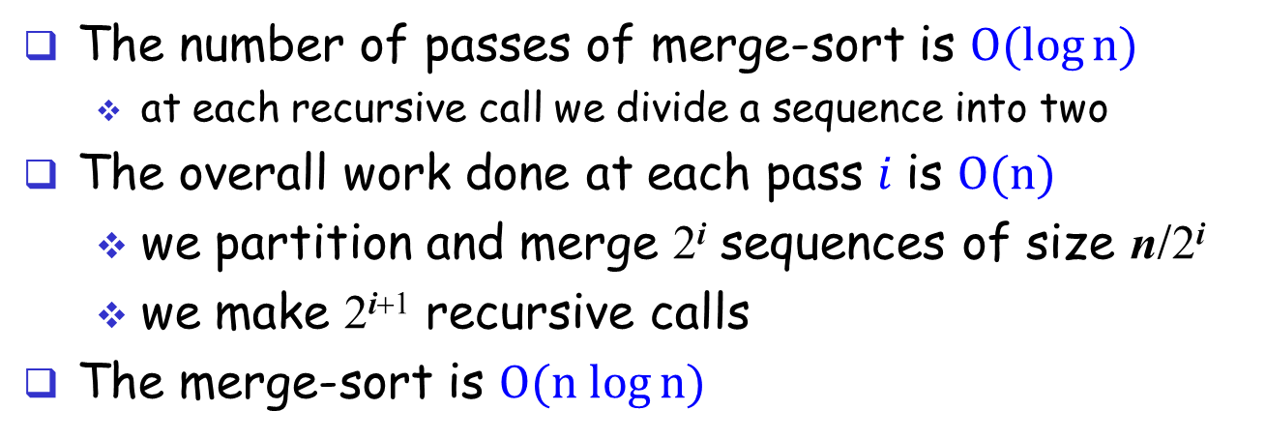
Merge-Sort: Big-Oh
The number of passes of merge-sort is $O(log⁡n)$
at each recursive call we divide a sequence into two
The overall work done at each pass $i$ is $O(n)$
we partition and merge 2^{i} sequences of size n/2^{i}
we make 2^{i+1} recursive calls
The merge-sort is $O(n log⁡n)$
pass | #seqs | size
0 | 1 | n
1 | 2 | n/2
i | 2^{i} | n/2^{i}
… | … | …

Slide 37
HeapSort
In Chapter 5, we discussed max heap.
Consider sorting a set of n numbers into a non-increasing order using max heap.
We can construct an initial max heap by inserting all numbers into the max heap.
Then, we can repeatedly delete one (max number) from the max heap until the max heap becomes empty.

Slide 38
HeapSort
[1]
20
Let’s go through heapSort to sort a set of numbers in an array a[1..n] of size n.
Consider an example of (14, 15, 2, 10, 20).
Insert all numbers in such an order into a max heap.
Delete the max number at a time, and reconstruct the heap.
The sorting result will be (2, 10, 14, 15, 20) if we place the deleted number from the end of an array.
[2]
15
[3]
2
[4]
10
[5]
14
Initial heap
[1]
15
[2]
14
[3]
2
[4]
10
After deletion of 20

Slide 39
HeapSort
In the previous slide, it shows that all numbers are initially stored in an array. We create a new empty max heap using another array, and insert all numbers into the max heap one by one.
Can we do faster to create a max heap?
Do we need to use two arrays?
Reconsider an example of (14, 15, 2, 10, 20). We can view it as a binary tree.
Can we make the binary tree as a max heap?
[1]
14
[2]
15
[3]
2
[4]
10
[5]
20
The input array

Slide 40
HeapSort
In order to make a binary tree as a max heap, we design an algorithm to adjust a binary tree to be a max heap.
adjust(the-array, the-root, the-size)
The array represents a max heap which is a complete binary tree.
Consider the root of a subtree.
Assume its left subtree is a max heap, and its right subtree is a max heap.
Make the subtree as a max heap.
[1]
14
[2]
15
[3]
2
[4]
10
[5]
20
The initial binary tree

Slide 41
HeapSort: Adjust
[1]
14
The pseudo code void adjust(int a[], int root, int n) { int child, temp; temp = a[root]; child = 2 * root; /* left child */ while (child <= n) { if ((child < n) && (a[child] < a[child+1])) child++; /* change to right child if right is larger */ if (temp > a[child]) break; /* larger than max child? */ else { a[child/2] = a[child]; /* move to the parent */ child *= 2; } } a[child/2] = temp; }
[2]
15
[3]
2
[4]
10
[5]
20
The initial binary tree

Slide 42
HeapSort:
The pseudo code void heapSort(int a[], int n) { /* sort a[1..n] */ int i, j, temp; /* make initial max heap */ for (i = n/2; i > 0; i--) adjust(a, i, n); /* move the largest number to the end of the array, and adjust it again */ for (i = n-1; i > 0; i--) { SWAP(a[1], a[i+1], temp); adjust(a, 1, i); } }
[1]
14
[2]
15
[3]
2
[4]
10
[5]
20
The initial binary tree
[1]
20
[2]
15
[3]
2
[4]
10
[5]
14
After the 1st for loop

Slide 43
Example of HeapSort
Given array a[1..n] (n=5): 14 15 2 20 10
Initial max-heap (n=5): 20 15 2 14 10
For i = n-1 down to i=1 do
Swap a[i+1] with a[1] (i=4): 10 15 2 14 20
Adjust max-heap (i=4): 15 14 2 10 20
Swap a[i+1] with a[1] (i=3): 10 14 2 15 20
Adjust max-heap (i=3): 14 10 2 15 20
Swap a[i+1] with a[1] (i=2): 2 10 14 15 20
Adjust max-help (i=2): 10 2 14 15 20
Swap a[i+1] with a[1] (i=1): 2 10 14 15 20
Adjust max-help (i=1): 2 10 14 15 20

Slide 44
HeapSort: An Example
Consider a larger example (refer to Figure 7.7 and Figure 7.8 in the textbook.)
Let an initial array be (26, 5, 77, 1, 61, 11, 59, 15, 48, 19)

Slide 45
How Is Data Sorted?
Data can be in order before sorting.
Random
Nearly sorted
Reverse
Few unique
See http://www.sorting-algorithms.com/ for animation.

Slide 46
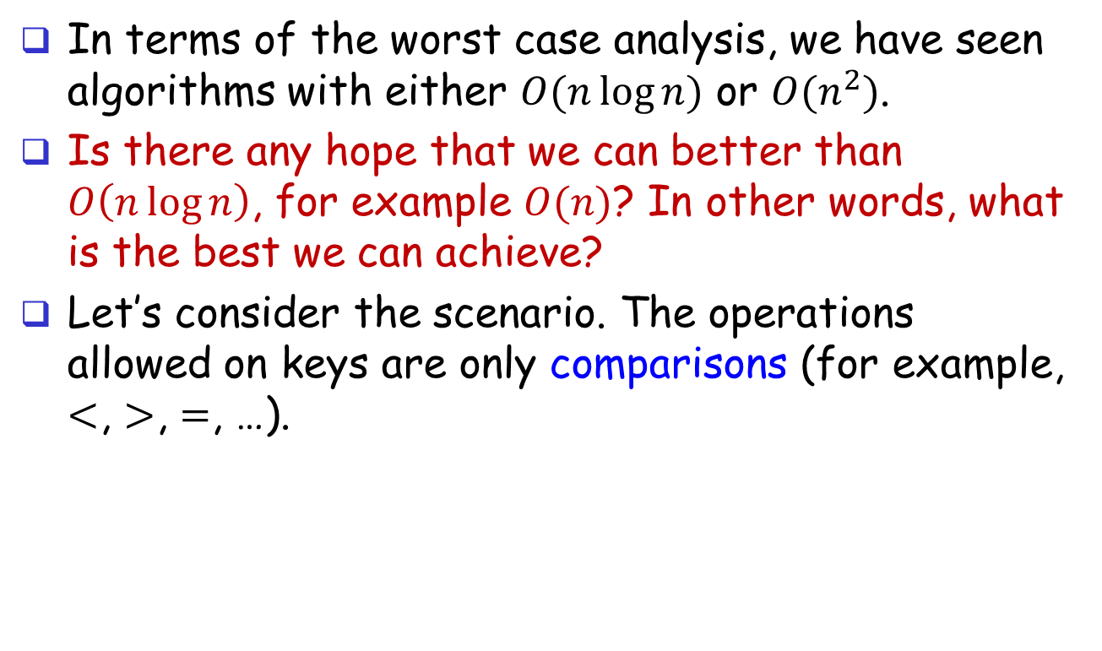
How Fast Can We Sort?
In terms of the worst case analysis, we have seen algorithms with either $O(n\log{n})$ or $O(n^{2})$.
Is there any hope that we can better than $O\left(n\log{n}\right)$, for example $O(n)$? In other words, what is the best we can achieve?
Let’s consider the scenario. The operations allowed on keys are only comparisons (for example, $<$, $>$, $=$, …).

Slide 47
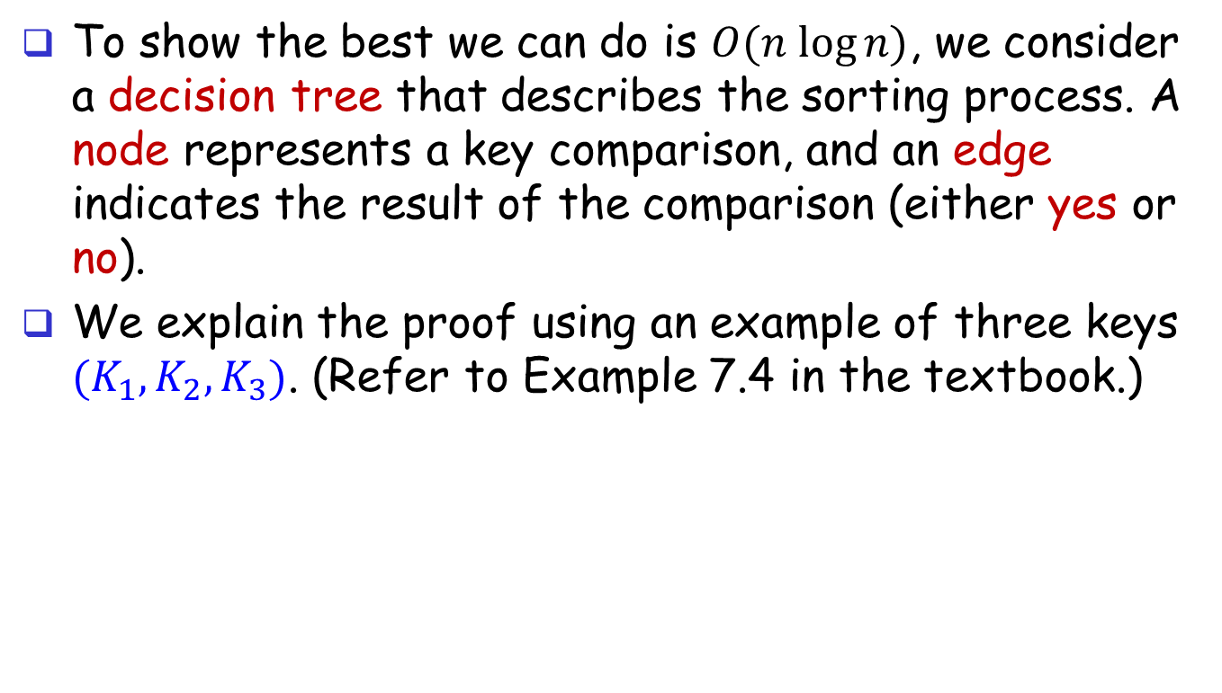
How Fast Can We Do?
To show the best we can do is $O(n log⁡n)$, we consider a decision tree that describes the sorting process. A node represents a key comparison, and an edge indicates the result of the comparison (either yes or no).
We explain the proof using an example of three keys $(K_{1},K_{2},K_{3})$. (Refer to Example 7.4 in the textbook.)

Slide 48
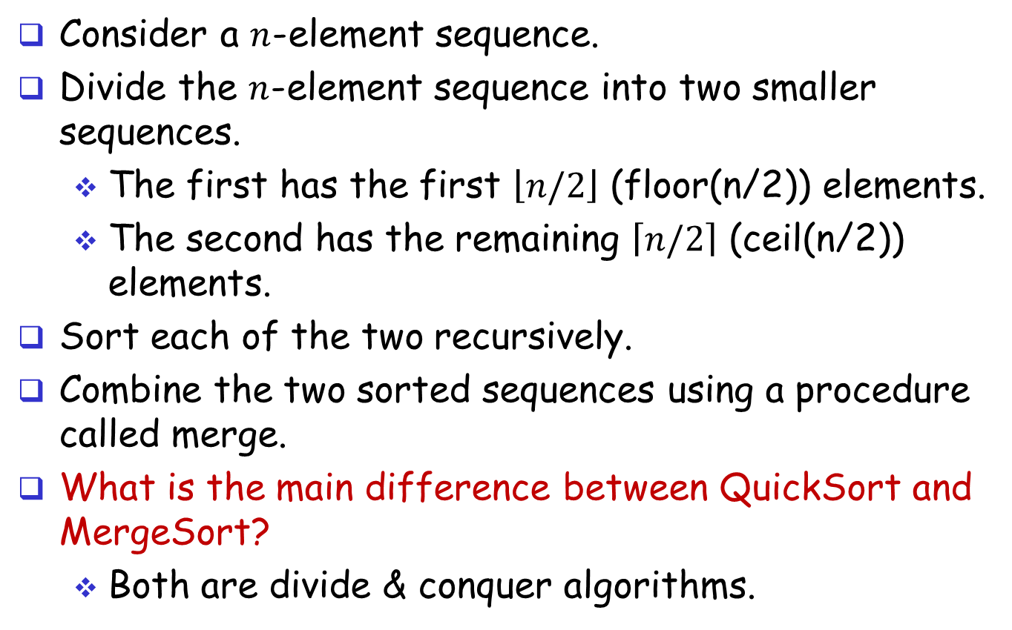

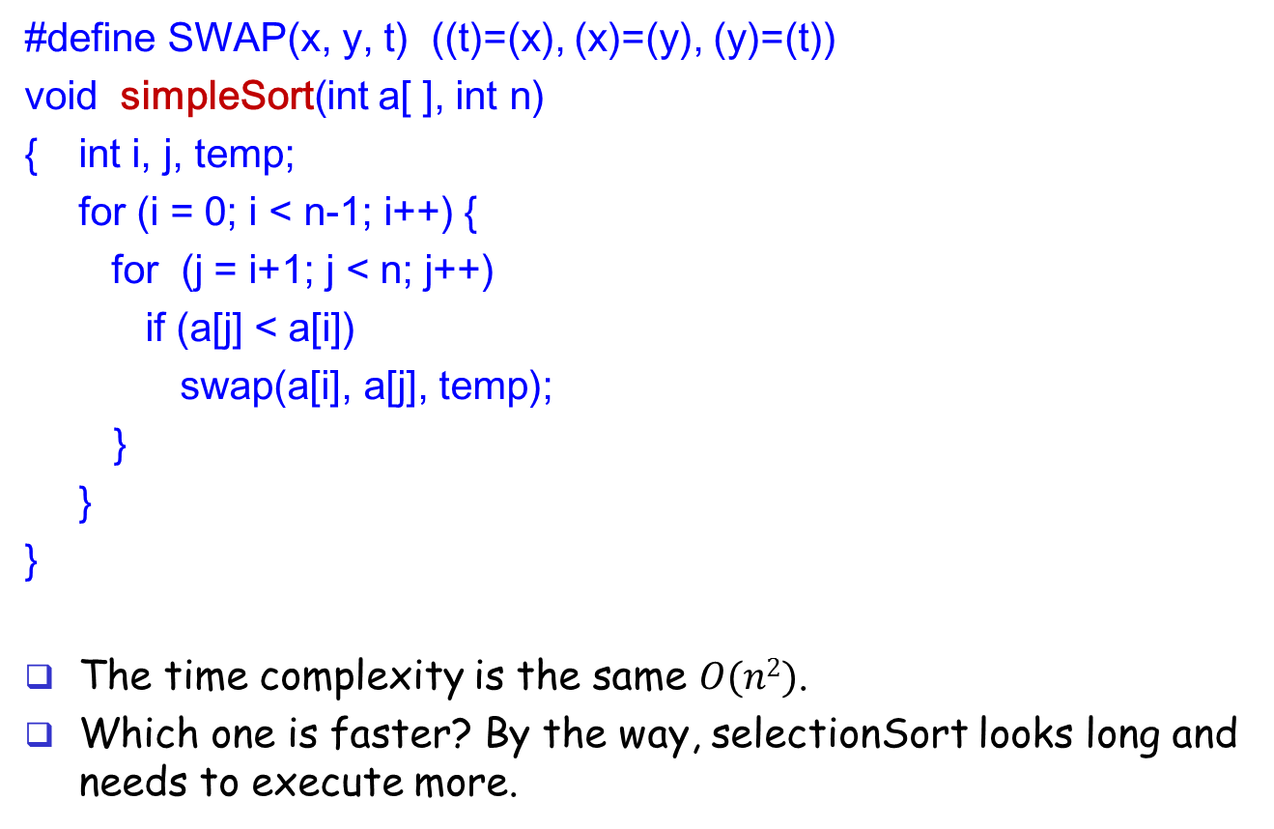
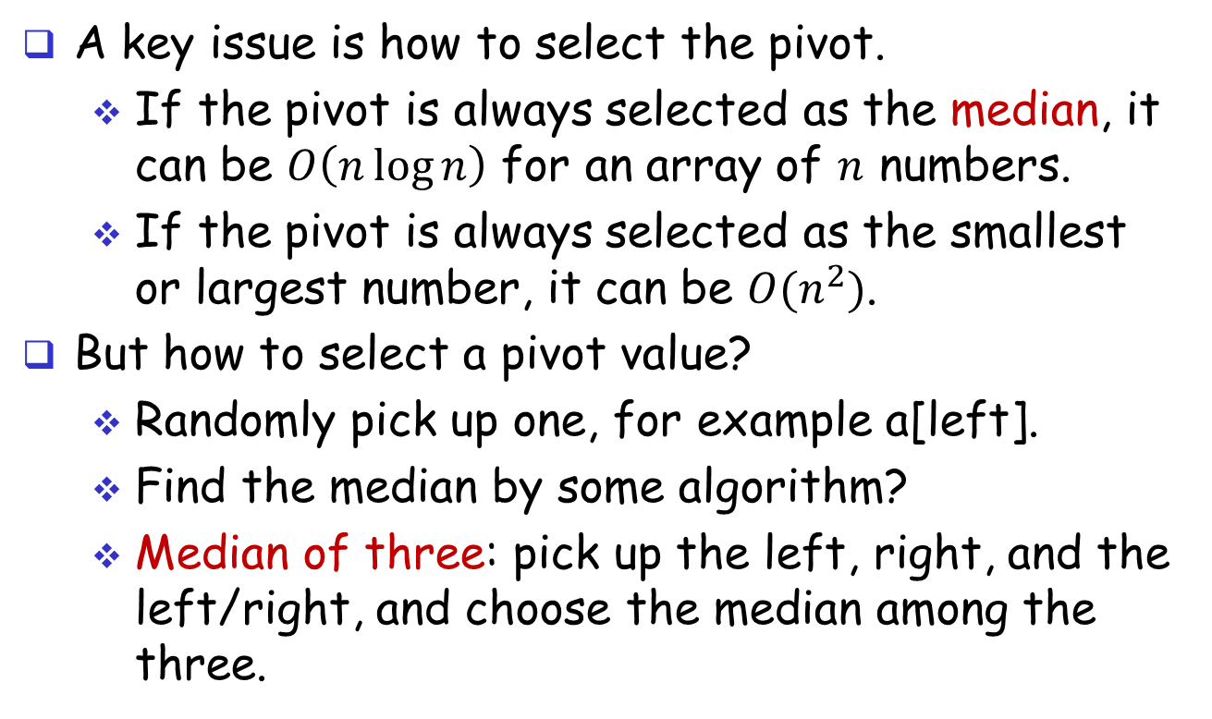

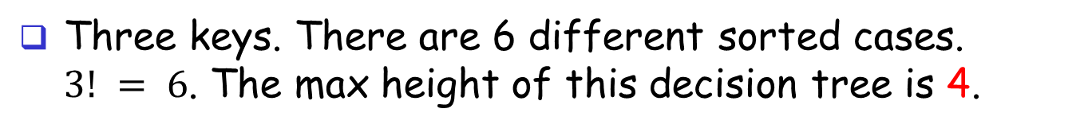

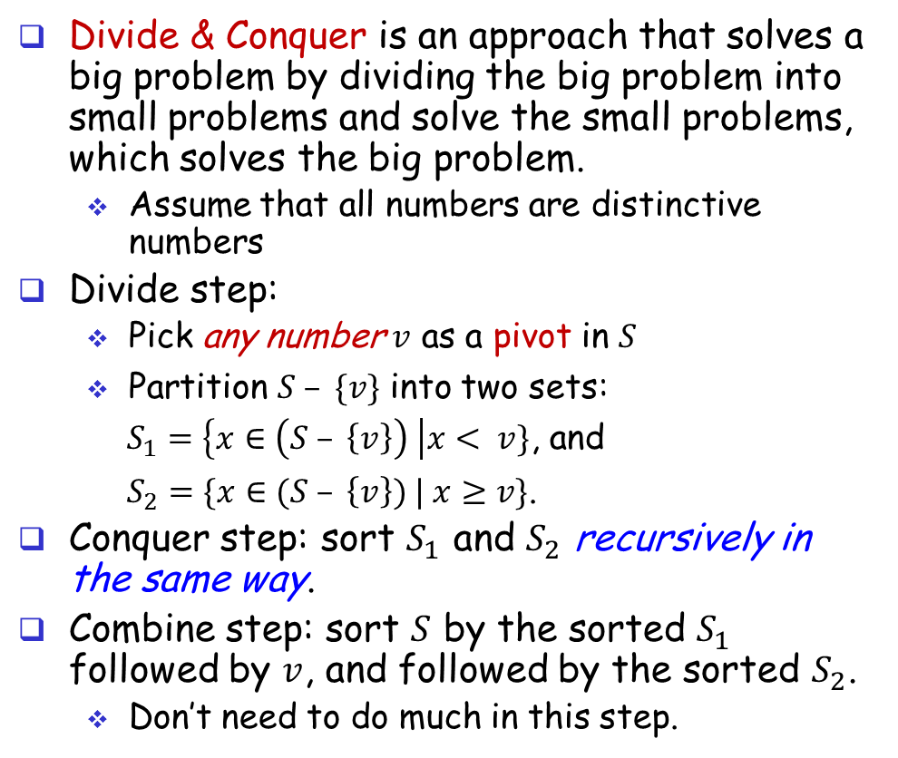
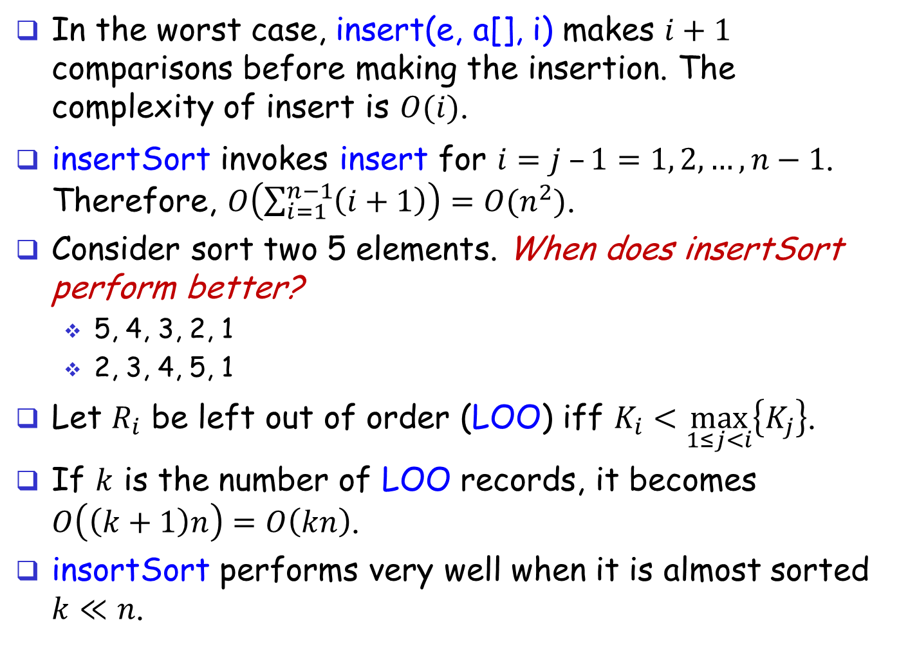


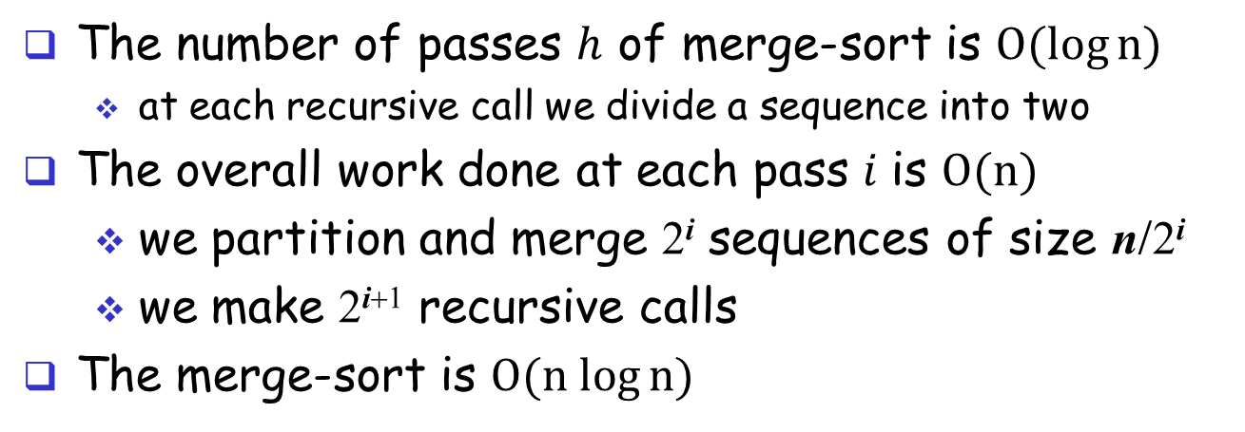
How Fast Can We Do?
$$K_{1}≤ K_{2}$$
$$[K_{1},K_{2},K_{3}]$$
yes
no
$$[K_{1},K_{2},K_{3}]$$
$$K_{2}≤ K_{3}$$
$$K_{1}≤ K_{3}$$
$$[K_{2},K_{1},K_{3}]$$
yes
no
yes
no
sorted
$$K_{1}≤ K_{3}$$
$$[K_{1},K_{3},K_{2}]$$
$$K_{2}≤ K_{3}$$
$$[K_{2},K_{3},K_{1}]$$
$$[K_{1},K_{2},K_{3}]$$
no
sorted
yes
no
yes
sorted
sorted
$$[K_{2},K_{1},K_{3}]$$
$$[K_{1},K_{3},K_{2}]$$
$$[K_{3},K_{1},K_{2}]$$
sorted
sorted
$$[K_{2},K_{3},K_{1}]$$
$$[K_{3},K_{2},K_{1}]$$
Three keys. There are 6 different sorted cases. $3! = 6$. The max height of this decision tree is 4.

Slide 49
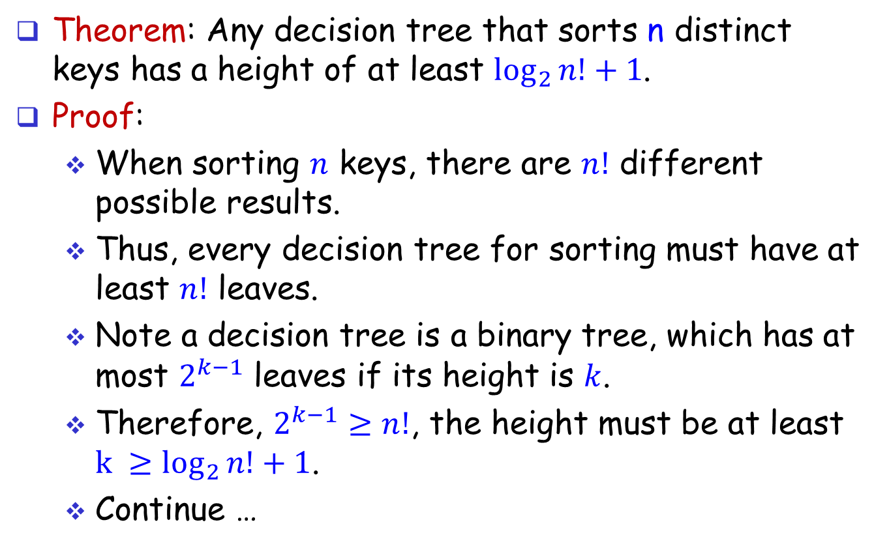
How Fast Can We Do?
Theorem: Any decision tree that sorts n distinct keys has a height of at least $\log_{2}{n!+1}$.
Proof:
When sorting $n$ keys, there are $n!$ different possible results.
Thus, every decision tree for sorting must have at least $n!$ leaves.
Note a decision tree is a binary tree, which has at most $2^{k−1}$ leaves if its height is $k$.
Therefore, $2^{k−1}≥n!$, the height must be at least ${k ≥log}_{2}{n!}+1$.
Continue …

Slide 50
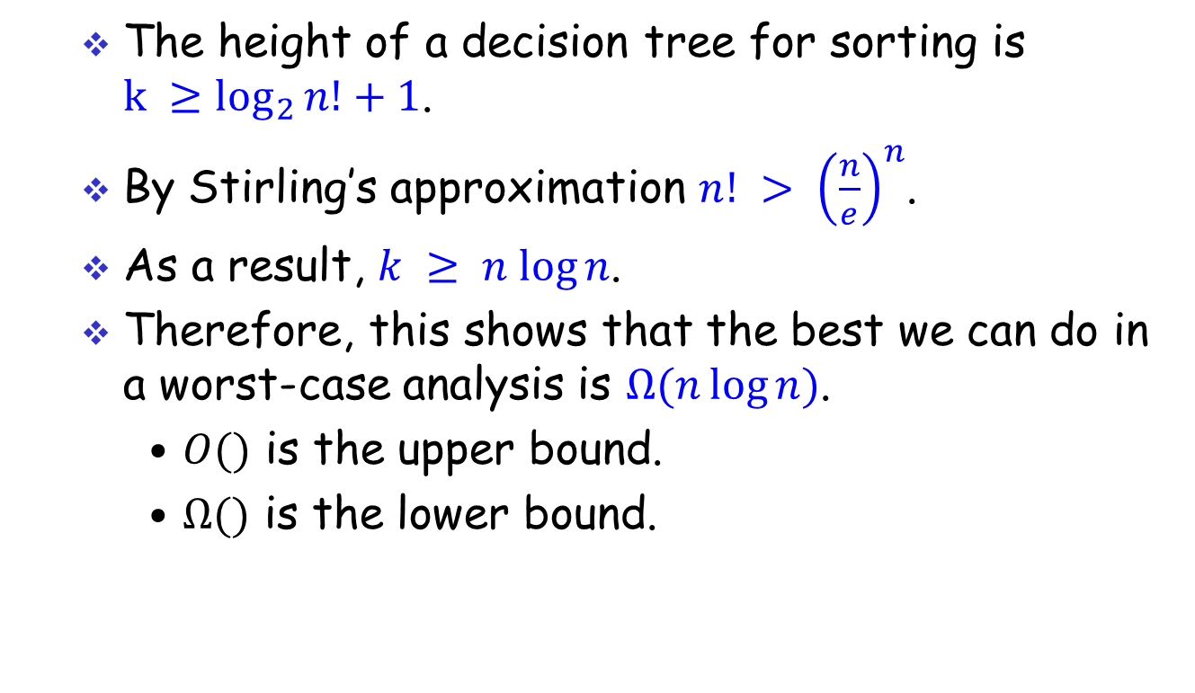
How Fast Can We Do?
The height of a decision tree for sorting is ${k ≥log}_{2}{n!}+1$.
By Stirling’s approximation $n! > {\left(\frac{n}{e}\right)}^{n}$.
As a result, $k ≥ n log⁡n$.
Therefore, this shows that the best we can do in a worst-case analysis is $Ω(n\log{n})$.
$O()$ is the upper bound.
$Ω()$ is the lower bound.

